Slide 1
Emergence of statistical physics in a trapped ion quantum simulator
Diego Porras
University of Sussex

Slide 2

In classical physics, we expect statistical mechanics to emerge as a result of the ergodic principle.
Ergodicity: an isolated system is assumed to “visit” all the microscopic states with the same energy with the same probability.
$$\{x_{n}\left(t\right), p_{n}(t)\}$$
Microcanonical
ensemble

Slide 3
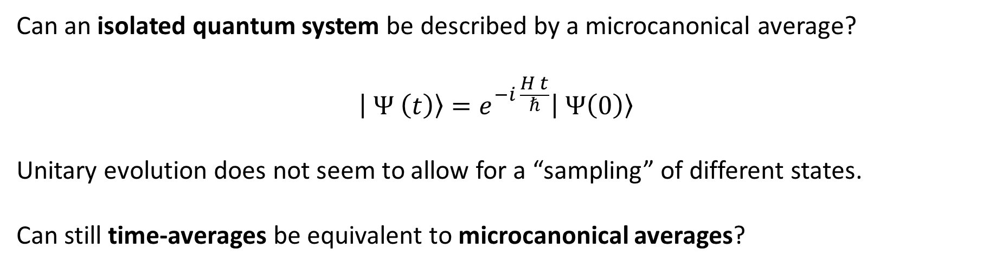

Can an isolated quantum system be described by a microcanonical average?
$$| Ψ \left(t\right)〉=e^{−i \frac{H t}{ℏ}}| Ψ\left(0\right)〉$$
Unitary evolution does not seem to allow for a “sampling” of different states.
Can still time-averages be equivalent to microcanonical averages?
$\frac{1}{T}\int_{0}^{T}{〈Ψ(t)|A| Ψ \left(t\right)〉 dt }=∫dE p\left(E\right)〈Ψ_{E}|A | Ψ_{E}〉$ ??
(for some narrow probability distribution $p(E)$, centered around the mean energy of the initial state, $|Ψ\left(0\right)〉$)

Slide 4
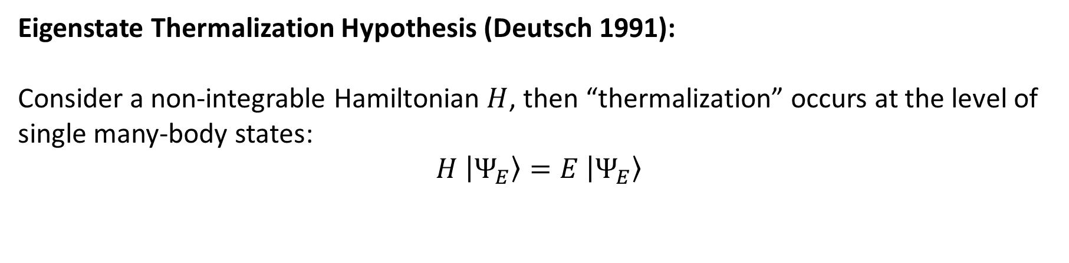

Eigenstate Thermalization Hypothesis (Deutsch 1991):
Consider a non-integrable Hamiltonian $H$, then “thermalization” occurs at the level of single many-body states:
$$H |Ψ_{E}〉=E |Ψ_{E}〉$$
$$〈Ψ_{E}|A | Ψ_{E}〉≈∫dE^{′}p\left(E^{′}−E\right)〈Ψ_{E′}|A | Ψ_{E′}〉$$
(Mean-values with respect to a single energy eigenstate are equivalent to microcanonical averages)

Slide 5
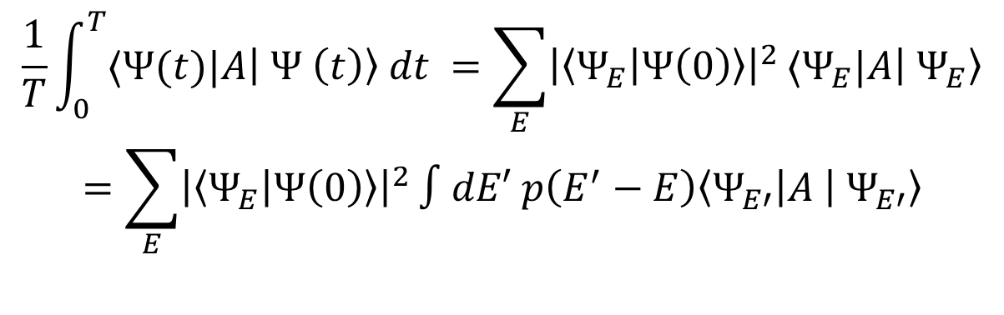
The E.T.H. leads to ergodicity (equivalency between time-average and microcanonical average)
$$\frac{1}{T}\int_{0}^{T}{〈Ψ(t)|A| Ψ \left(t\right)〉 dt }=\sum_{E}{{\left|〈Ψ_{E} | Ψ\left(0\right)〉\right|}^{2}}〈Ψ_{E}|A| Ψ_{E}〉$$
$$=\sum_{E}{{\left|〈Ψ_{E} | Ψ\left(0\right)〉\right|}^{2}}∫dE′ p\left(E^{′}−E\right)〈Ψ_{E′}|A | Ψ_{E′}〉$$
In essence: the details of the particular energy probability distribution ${\left|〈Ψ_{E} | Ψ\left(0\right)〉\right|}^{2}$ are not important (each on of the contributions yield microcanonical averages)

Slide 6
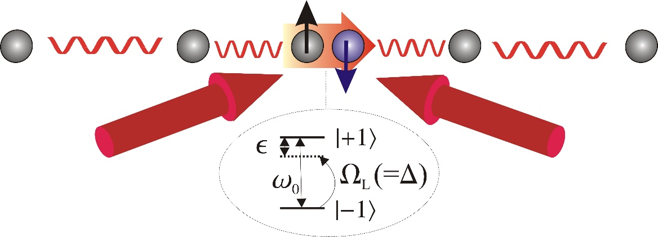
Trapped ion spin-boson quantum simulators

Slide 7
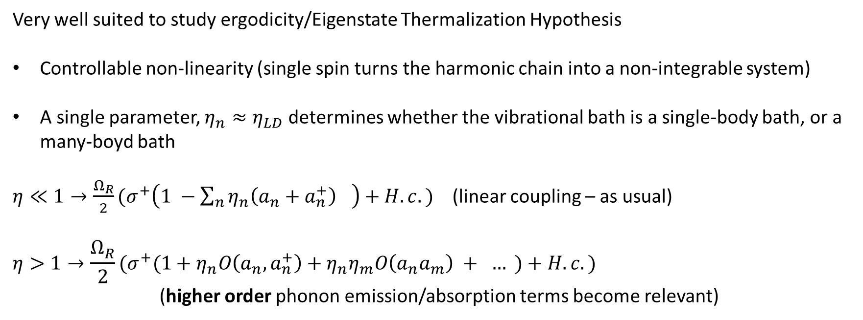
Trapped ion spin-boson quantum simulators
Very well suited to study ergodicity/Eigenstate Thermalization Hypothesis
Controllable non-linearity (single spin turns the harmonic chain into a non-integrable system)
A single parameter, $η_{n}≈η_{LD}$ determines whether the vibrational bath is a single-body bath, or a many-boyd bath
$η≪1→\frac{Ω_{R}}{2}(σ^{+}\left(1 −{\sum_{n}{η_{n}\left(a_{n}+a_{n}^{+}\right)}}_{}\right)+H.c. )$ (linear coupling – as usual)
$$η>1→\frac{Ω_{R}}{2}(σ^{+}(1+η_{n}O\left(a_{n},a_{n}^{+}\right)+η_{n}η_{m}O\left(a_{n}a_{m}\right) + … )+H.c. )$$
(higher order phonon emission/absorption terms become relevant)

Slide 8
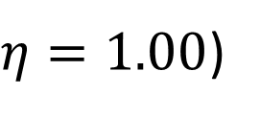

Ergodicity phase-diagrams (deviation with respect to the E.T.H. prediction)
ergodic
ergodic
$$η=0.33$$
$η=1.00$)

Slide 9

$$η=1.00$$

Slide 10
When do time-averages correspond to microcanonical averages?
How do time-fluctuations depend on the system size (Eigenstate
Thermalization Hypothesis implies that they decay exponentially)
Numerics limited to N = 4,5 ions (depending on temperature)!!

Slide 11
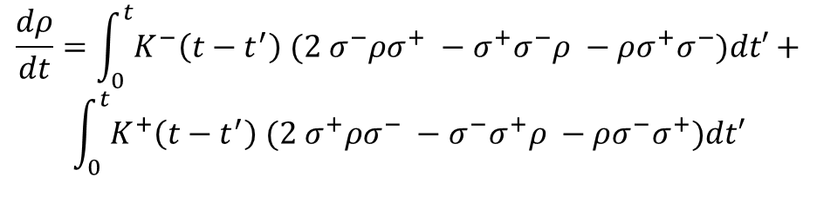
Applications:
Many-body sympathetic cooling: control the ergodicity of the trapped ion crystal to cool down efficiently systems of many ions (atomic clocks, quantum computing, metrology…)
Ideal test-bed to study non-markovian effects and finite size baths (N.I.B.A.-like methods:)
$$\frac{dρ}{dt}=\int_{0}^{t}{K^{−}\left(t−t^{′}\right){ (2 σ}^{−}ρσ^{+} −σ^{+}σ^{−}ρ −ρσ^{+}σ^{−})dt′}+$$
$$\int_{0}^{t}{K^{+}\left(t−t^{′}\right){ (2 σ}^{+}ρσ^{−} −σ^{−}σ^{+}ρ −ρσ^{−}σ^{+})dt′}$$
$$K^{±} \left(t−t^{′}\right)=〈O_{B}\left(t\right)O_{B}^{+}\left(t^{′}\right)〉 e^{± i ω_{z}t}$$

